Slide 1
RISK

Slide 2
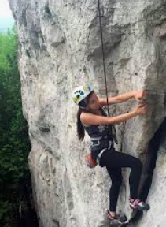
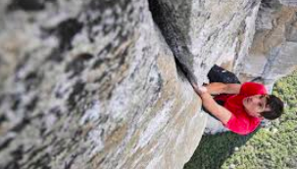
Risk and the outdoors
Risky situations? What comes to mind?
Risk is an underlying principle in all outdoor education
The exposure to risk/ challenge is what impels people to personal growth
Learning how to identify hazards, calculate risk and mitigate risk are important skills in the outdoors and are very transferrable to other aspects of your life

Slide 3
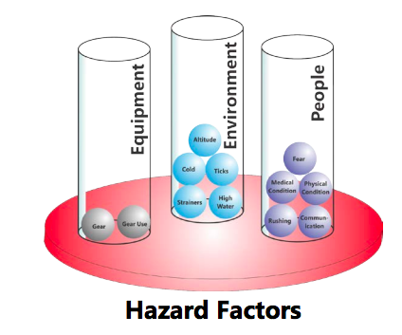
Hazards
A hazard is something that can cause harm
Examples – electricity, a cliff, chemicals, cold temperatures, hot temperatures, cold water, moving water
3 categories – environment, equipment and people ***ACTIVITY
The more hazards, the greater the potential for risks
But not all risks are the same size...

Slide 4
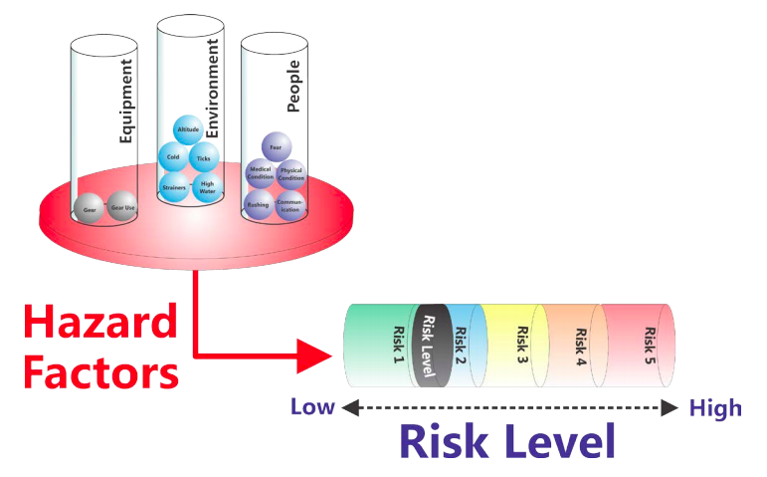
Risk
A risk is the chance, high or low, that any hazard will cause harm
Examples- How likely are you to be attacked by a shark while sea kayaking in Haines, Alaska? How likely are you to get into a car accident while driving to Haines, Alaska?
Perceived risk – danger or harm that someone believes to be present
Actual risk – danger or harm that is actually present

Slide 5
Calculating Risk
STEP 1: Identify hazards for a given activity
STEP 2: Determine the probability of the hazard occurring and the severity of the consequence were it to happen (scale of 1-5)
STEP 3: Risk = probability * consequence
Examples:
Risk of getting blisters on a cross-country ski day outing = 3 * 1 = 3
Risk of getting blisters on a ski trip = 3 * 2 = 6
Risk of anaphylaxis on a cycling outing to the KDCC = 1 * 4 = 4
Risk of anaphylaxis on a cycling trip on the Annie Lake Road = 2 * 5 = 10

Slide 6
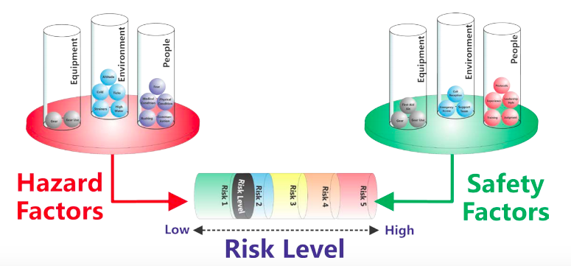
Mitigation of risk
Safety factors work to reduce the potential for harm
With the scale analogy, they work to counterbalance hazards
Examples – education, experience, first aid kit, judgment
Incidents can be prevented by minimizing exposure to unnecessary risk

Slide 7
Your turn…
Use the templates provided to list hazards and calculate risk values for them in specific scenarios
Conditions change – risk can be dynamic and you must be constantly reassessing your situation
The numbers are arbitrary but they provide opportunities for discussion and the identification of focus points for mitigation

