Slide 2
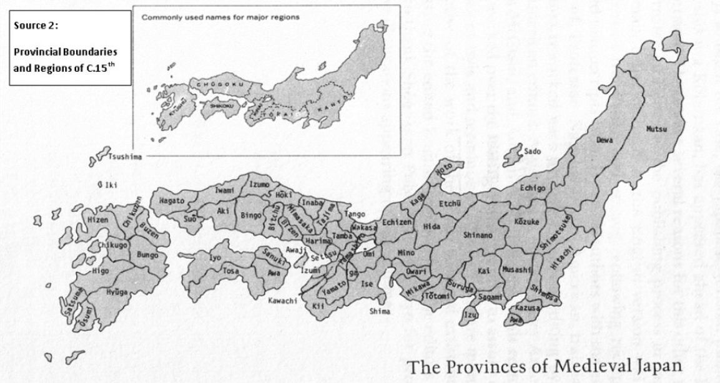

Slide 3
TIMELINE
Year | Event
2500-300 BCE | The Jomon Period when the first settlements appeared in Japan.
300 BCE | The start of the Yayoi Period. The Yayoi introduced the farming of rice.
593 | Prince Shotoku comes into power. He promotes Buddhism and brings peace to Japan.
781 | Emperor Kammu reigns over Japan.
1192 | The Kamakura Shogunate government is formed when Yoritomo is appointed the first Shogun.
1274 | The Mongols, led by Kublai Khan, attempt to invade Japan, but fail when a typhoon destroys much of the Mongol navy.
1336 | The Ashikaga Shogunate takes power.
1543 | The Portuguese arrive in Japan bringing firearms.
1590 | Japan is unified under the leadership of Toyotomi Hideyoshi. He establishes the Edo Shogunate.
1603 | Tokugawa Ieyasu becomes Shogun
1635 | Japan becomes isolated from the world restricting all foreigners except for a few Chinese and Dutch merchants. This period of isolation will last for more than 200 years.

Slide 4
Definitions
Feudal system - An order of society in which people are given different levels of power according to their job and status. Emperor - The supreme ruler over Japan. He was looked up to by all of his people, but held little power. Shogun - Probably the most important and powerful figure in society. He was in charge of military and all the decisions made in this field. He was ranked under the emperor, but held more power. Daimyo - A great leader who was the most powerful under the shogun. His job was manage a large area of land he was in charge of as well as serving the shogun. The daimyo also paid samurais to protect and work for them. Samurai - A japanese warrior (similar to a knight) who worked for the daimyo. They brought justice and order to the community and protected their people.

Slide 5
Definitions
Ronin - In most simplest terms, a ronin is basically an 'ex-samurai'. Peasant - A worker who provided food for the community. Eg. a farmer or fisherman. Artisan - A worker skilled in a certain trade. Eg. clothes-making or swords-making. Merchant - Considered the lowest class in society. Their job was to trade and sell goods. Seppuku - Suicide with honour. It was commonly practised by samurais after the death of their daimyo, or if they had caused disgrace in any way. Bushido - Meaning 'Way of the warrior', Bushido was a strict code of conduct the samurai followed. Warlord - A military commander.

Slide 8
