Slide 1
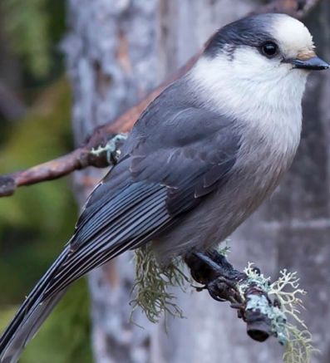
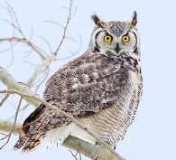
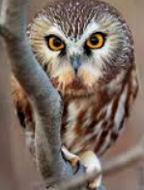
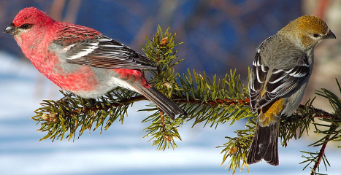
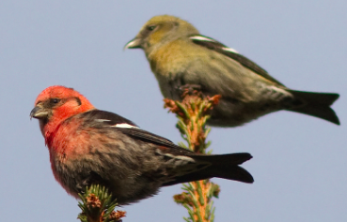
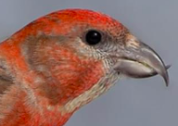
Week 2
Canada Jay
Perisorius canadensis
Great Horned Owl
Bulbo virginianus
Northern Saw-whet owl
Aegolus acadicus
Pine grosbeak
Pinicola enucleator
White-winged crossbill
Loxia leucoptera

