Slide 1
DNA Vocabulary

Slide 2
DNA
Deoxyribonucleic acid: stores the genetic information of an organism
Found in the nucleus

Slide 3
Nucleotides:
Chemical building blocks of DNA; four different possible options
Include a sugar, phosphate and nucleic acid

Slide 4
DNA sequence:
Specific order of nucleotides in an organism's DNA; genetic information code

Slide 5
Chromatin:
Condensed form of DNA usually found in cell's nucleus; coiled and compacted

Slide 6
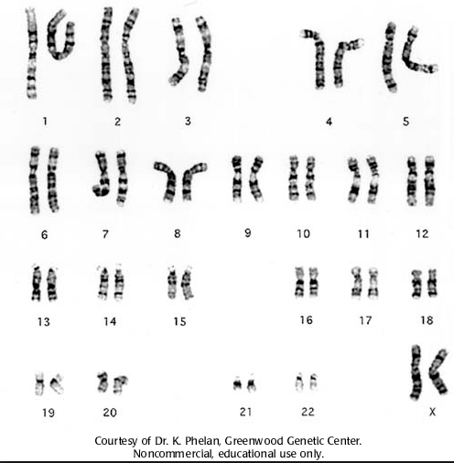
Chromosomes:
Very condensed form of DNA; only seen when cell begins to reproduce; often X-shaped

Slide 7
Deoxyribose
The sugar in DNA that makes up the sugar-phosphate backbone

Slide 8
Phosphate
Molecule (PO₄³⁻) that links deoxyribose sugars in the sugar-phosphate backbone

Slide 9
Nitrogenous base
Building blocks of DNA and RNA that connect to deoxyribose and join the two sugar-phosphate backbones

Slide 10
Adenine, cytosine, guanine and thymine
Nitrogen bases of DNA
Referred to as A, C, G and T

Slide 11
Complementary bases
Nitrogen bases pair up with a specific pattern
A – T (straight lines)
C – G (curved lines)

Slide 12
Double Helix
The shape of a DNA molecule
Twisted ladder

Slide 13
Hydrogen bond
The type of chemical bond that connects the nitrogenous bases together (A with T and C with G)

Slide 14
Gene
A section of DNA that codes for a specific protein

Slide 15
Mutation
A change in the DNA of an organism (addition, deletion or substitution of a nitrogenous base)
Can be helpful, harmful or have no effect

