Slide 1
Bienvenue!
Welcome!
Marhaba
Yak’ei yee xwsateení
Agatte
Tunngasugit
Shro Kwàthän Ni I

Slide 2
INTRODUCTIONS

Slide 3
Acknowledgement
We are fortunate to learn the traditional territory of the Kwanlin Dün and Ta’an Kwäch’än Council
We will also be spending time on other First Nations’ traditional territories throughout the semester (Champagne and Aishihik, Carcross-Tagish, Kaska Dena, others)

Slide 4
Our class
Partner introductions
Name game
Lego activity

Slide 5
SASE 9 program – Overview
Science 9, Social Studies 9, Physical Education 9, Outdoor Education 10
Integrated nature of courses/ outings
5 + numerous day-outings = ~50% time outside
One cohort, one teacher, numerous chaperones
Standards-based grading (extending, proficient, developing, emerging)
Outdoor Education 10 exception
Trial period (2 weeks)
Need to be flexible – plans will change (Expectations⁻¹=happiness)
Semester goals
Safety is a top priority
Spend time outside
Connect to other people and the world at large
Learn new skills and knowledge
Build confidence
Foster curiosity

Slide 6
Weekly schedule
Our general schedule looks like this:
PERIOD | MONDAY | TUESDAY | WEDNESDAY | THURSDAY | FRIDAY
1 |  | OUTING | Bouldering @ PCSS | OUTING
2 |  | OUTING |  | OUTING
3 |  | OUTING |  | OUTING
4 | Work out @ PCSS | OUTING |  | OUTING

Slide 7
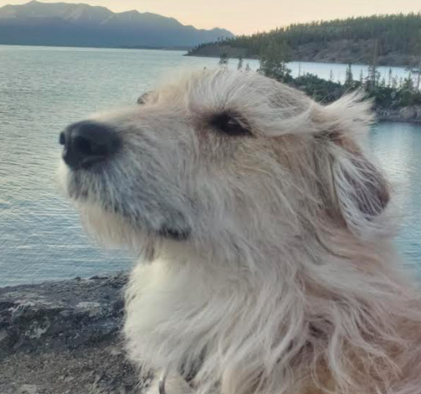
Ms. McDade…

Slide 8
Ms. McDade continued…
My full name is Laura Kathleen McDade
You can call me Ms. McDade
My pronouns are she/ her
My learning style is a mixture of visual, auditory, verbal, physical, social and solitary
My favourite things to do outside of school are wandering in the forest, skiing and playing music
My favourite musician is Sara Bareills
I like to snacks. Lots of snacks. Goldfish crackers always hit the spot.
I am most excited about sharing experiences with all of you this semester
I am most nervous about managing my concussion

Slide 9
Student Information Profiles
Please take some time to fill out your student information profile
Hand it in when you are done

Slide 10
HOUSEKEEPING

Slide 11
SASE 9 space
Assigned desks/ lockers
Cell phone chateau/ mailbox
Footwear/ coats
Kitchen – no water!
In-class washroom – no water!
Non-student space
Keep things organized/ clean/ tidy
Gear room
Gear storage shed
Drying gear under school – helmets

Slide 12
Breaks and lunch
Washroom
Changing for outings
Breaks as directed by teacher
Lunch – no set time; bring your own
Bring a water bottle – fill it at home
Avoid entering school
Get outside, play games, minimize phone time

Slide 13
Cell phones
No cell phones during class time
Keep them in your bags or lockers
You lose it if you use it
Emergencies? Something comes up that needs immediate attention? Talk to me and we’ll work something out.
No phones on outings or trips

Slide 14
Emergencies
Fire – exit down ramp to ball field…or student parking lot
Earthquake – get under your desks, protect your heads and spines
Lockdown – bathroom, kitchen

Slide 15
Being prepared
Binder with paper, pen, pencil, eraser, pencil crayons, ruler
Brain turned onto growth mindset mode
Outdoor clothing/ gear/ other items on
equipment lists as needed

Slide 16
Lates and absences
Don’t be late – you risk missing activities
Absences
You may be absent for a short or long period or time this year
You are expected to stay caught up with class work and arrange to join via zoom whenever possible
My website will be updated daily
Contacting me via email with concerns is the best – kathleen.mcdade@yesnet.yk.ca
Don’t skip. I will call your parents. Admin will get involved. You may not be able to participate on trips.
***If you know you will be late or absent, have your parents call the school AND email me

Slide 17
Drugs and alcohol
Zero tolerance for use or possession of drugs
You will be suspended, you will meet with the school admin and your parents, you may have to do mandatory counselling, the police may be involved, you may be removed from a trip at your parents’ expense, you may be suspended, you may be expelled
Fentanyl
Cigarettes and vaping

Slide 18
Relationships
There will be no SASE babies
You only get to learn about reproduction in science and health education – there is no experiential component
Relationships and exclusivity

Slide 19
SASE Code of Conduct
Read
Discuss
Initial
Co-create expectations for ”The Big 2” – safety and respect

Slide 20
Support
Everyone at PCSS wants you to succeed in high school. Teachers are here to support you with your academics and your social-emotional needs.
Ms. Seymour is the grade 8/9 counsellor and she can provide additional help and resources
PCSS has an amazing GSA – talk to Mr. Cook/ visit the rainbow room
811 – Yukon healthline
Mental health – 1-844-533-3030

Slide 21
COURSES

Slide 22
Outdoor Education 10
Credit course!
Standards-based grading translated to a final percentage grade
Course outline
Calendar
Gear list – check off

Slide 23
Physical and Health Education 9
Course outline

Slide 24
Science 9
Course outline
Text book search
Final exam

Slide 25
Social Studies 9
1750-1919
Course outline
Final project

Slide 26
Activity
Cross-country ski boot fitting
Telemark ski boots and ski fitting

Slide 27
DOCUMENTS

Slide 28
Important documents
Assessment trackers and journals
Semester calendar – hard copy, google doc (link on website)
Parent information and forms – meeting @ 6pm tonight!

Slide 29
Website and communication
Mcdadepcss.weebly.com
Google drive for photos from semester
Email is the best way to get ahold of me Kathleen.mcdade@yesnet.yk.ca

Slide 30
AFTERNOON ACTIVITIES

Slide 31
Activities
Fire starter kits
Labelling journals
Games
Birds!
Risk
Assessment entry

