Slide 1
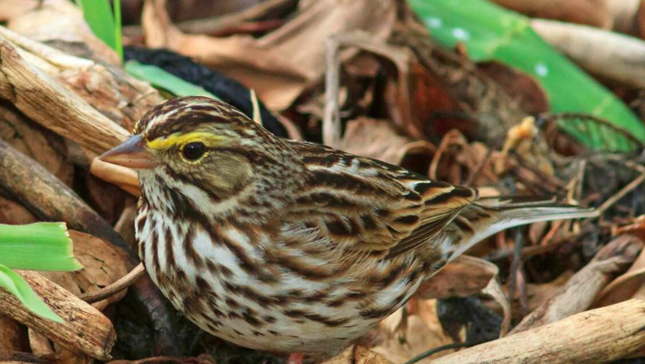
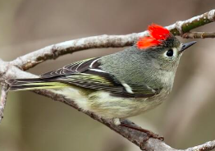
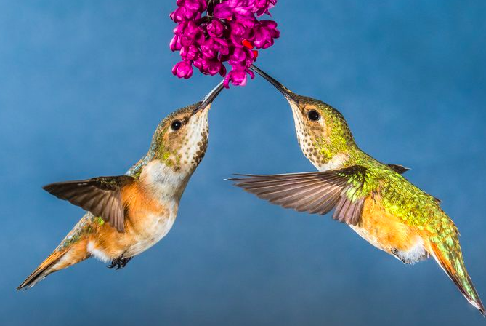
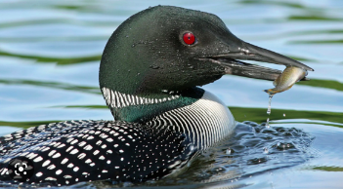
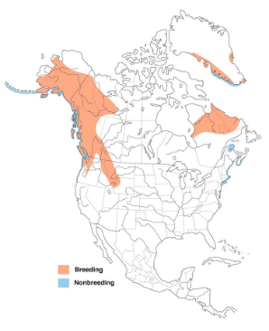
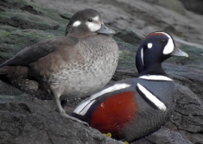
Week 7 – Woo!
Savannah sparrow
Passerculus sandwichensis
Ruby crowned kinglet
Regulus calendula
Common loon
Gavia immer
Harlequin duck
Histrionicus histrionicus
Rufous hummingbird
Selasphorus rufus

